Slide 1

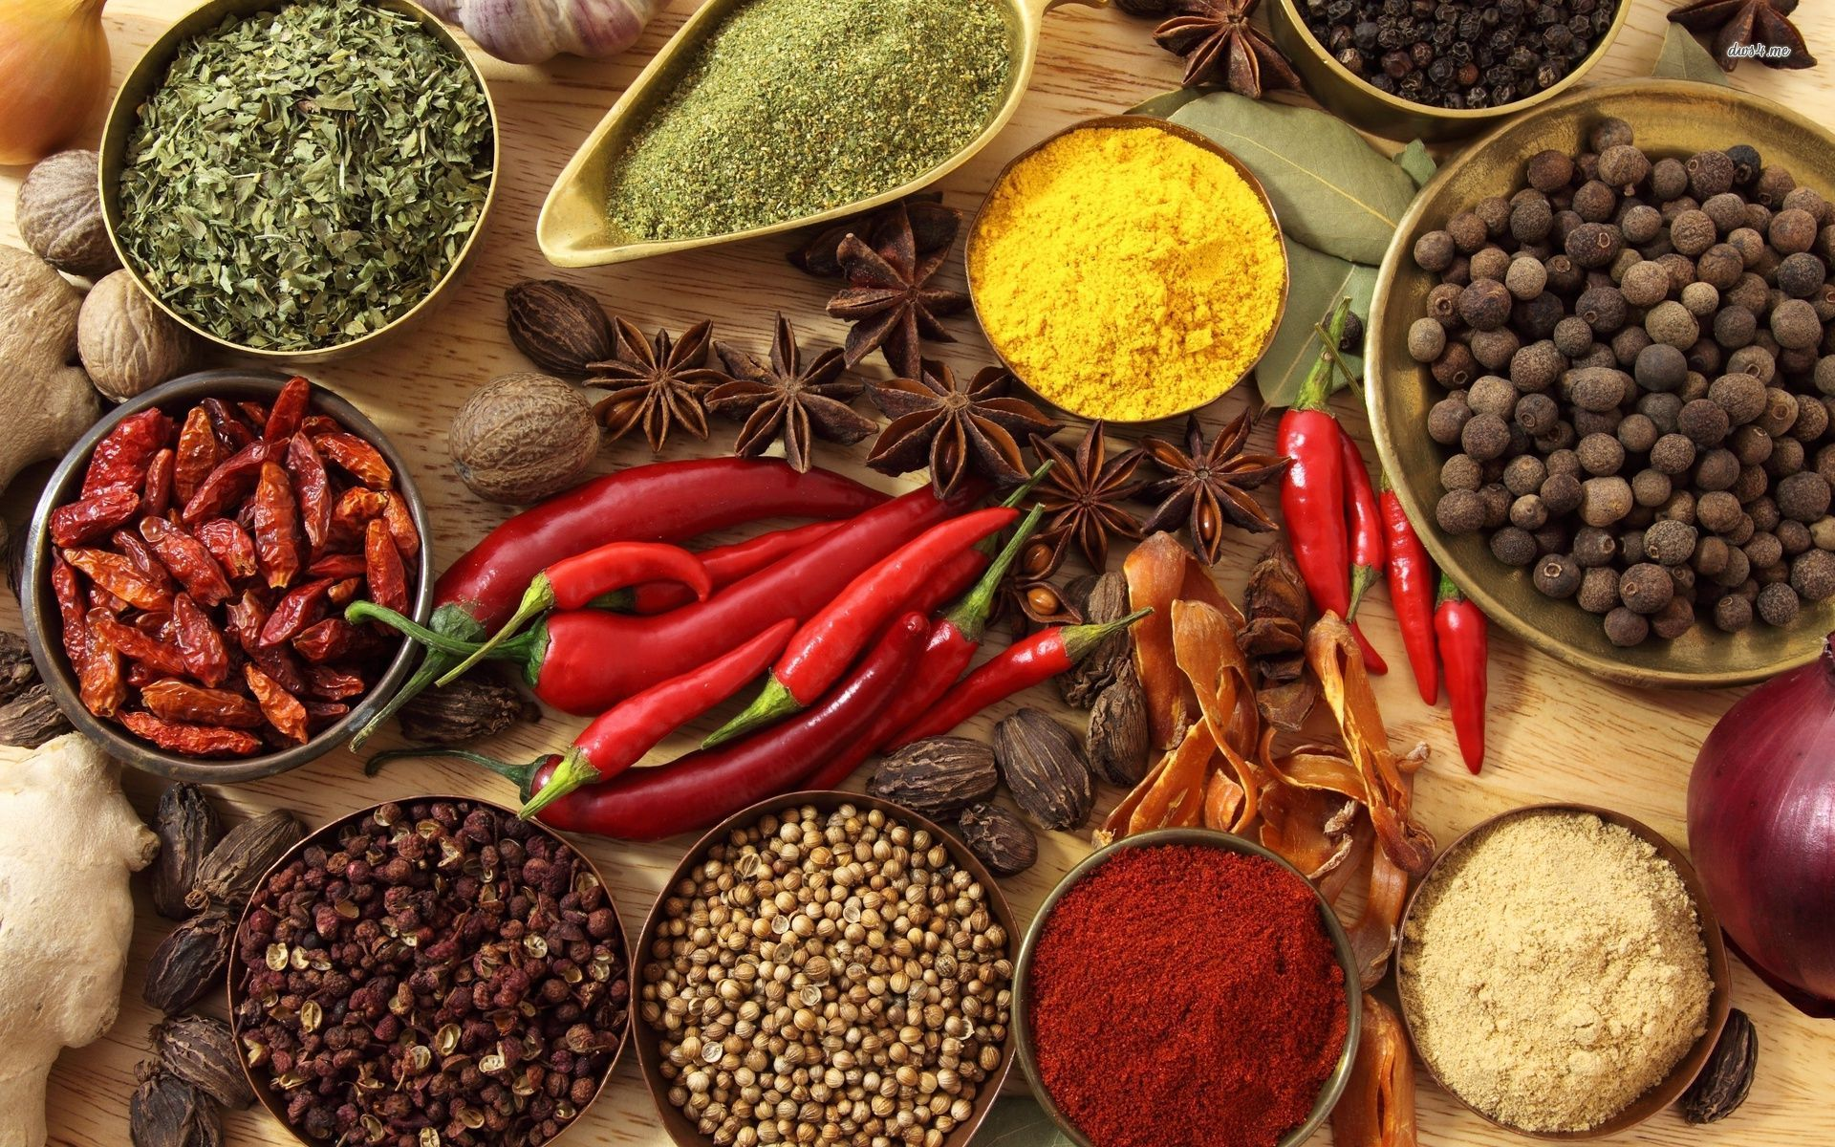
Bhojan
An easy guide to Indian Cuisine

Slide 2
COMP-436 Fall 2017 Group E
By:
Suchitra Gopal
Rishi Patel
Pranjali Mishra
Salma Qamar

Slide 3
“What you eat today will influence the way you think, in turn influencing your future. Eat lovingly and you will be loved; eat mercilessly and the world will not be compassionate to you.”
Moni Singh

Slide 4
Introduction
The traditional food of India has been widely appreciated for its fabulous use of herbs and spices.
Indian cuisine is known for its large assortment of dishes.
The cooking style varies from region to region and is largely divided into four parts as per their geographical locations:
South Indian Food
North Indian Food

Slide 5
Approach
Indian recipes are known for its complex aromatic flavors, which makes it a little bit tricky to try cooking it.
We have tried to simplify the recipes in terms of ingredients involved and the cooking procedure.
We render the recipes using markup languages for making it easy to understand/DIY.

Slide 6
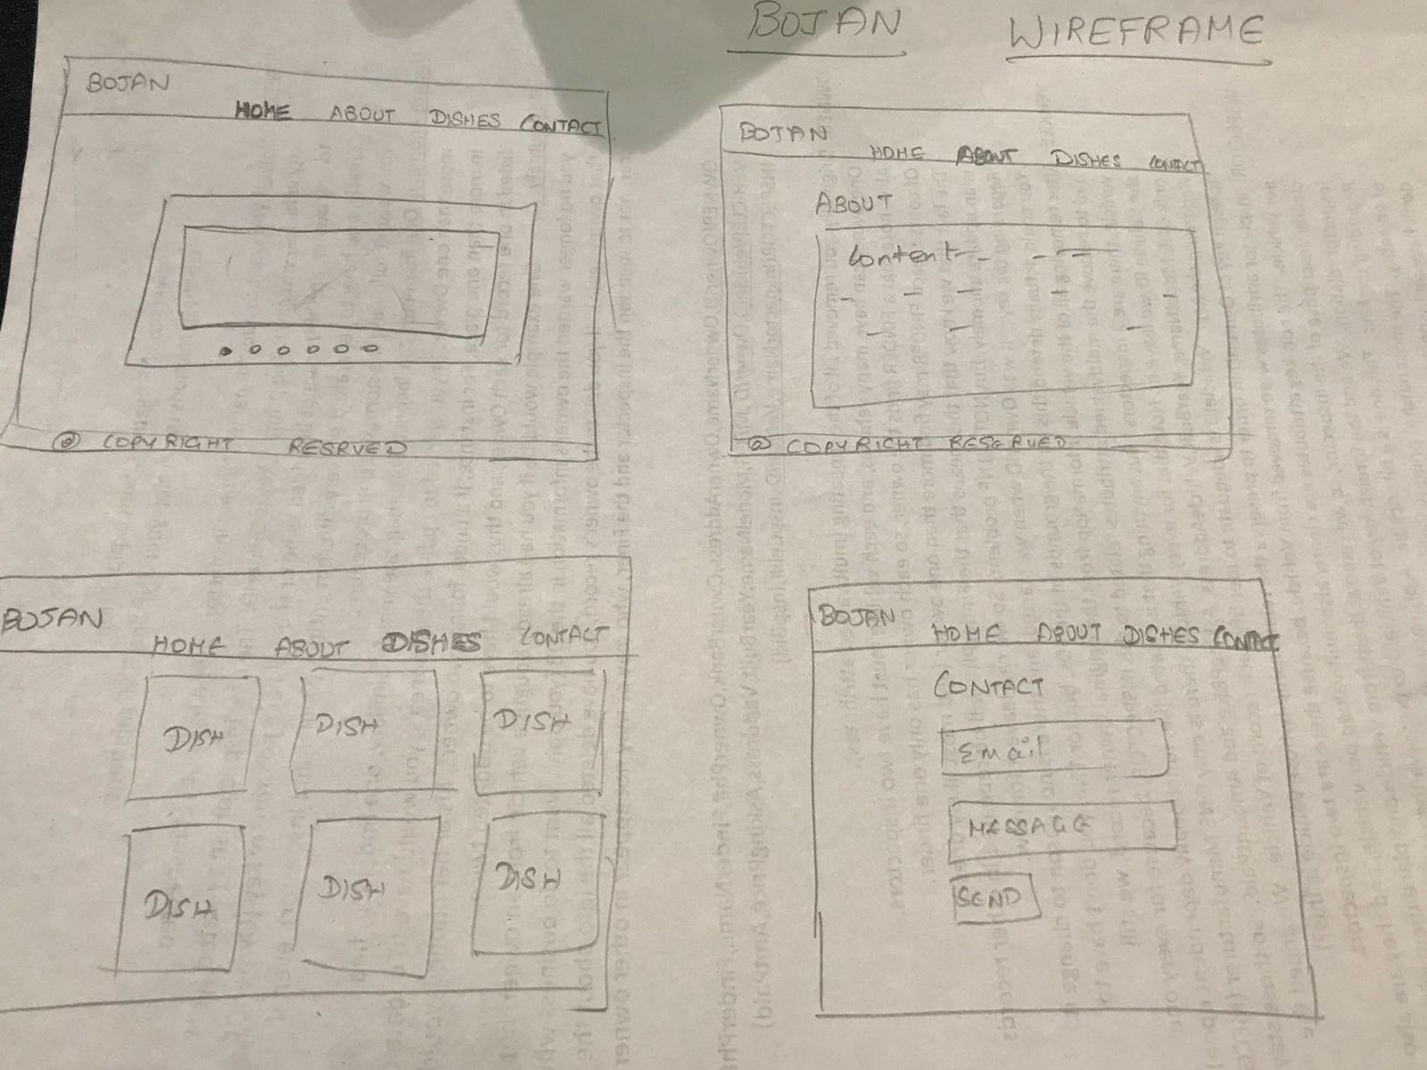
Mockup UI Design

Slide 7





Programming languages used:
JavaScript And JQuery

Slide 8
Metadata:
We included the Metadata under the following Tags:
<meta name="description" content="Indian Cuisines">
<meta name="keywords" content="food, india, indian food, cuisines, spices, traditional food, south indian, north indian">
<meta name ="place" content = "India,Tamilnadu, Punjab, Hyderabad, Kolkatta “>

Slide 9
Enhancements from Dev Week!!
Classification narrowed down to North and South
Grid view
Pagination
Video links
Detailed View
Filter: Allergy, Taste and Duration
Deployment: Heroku

Slide 10
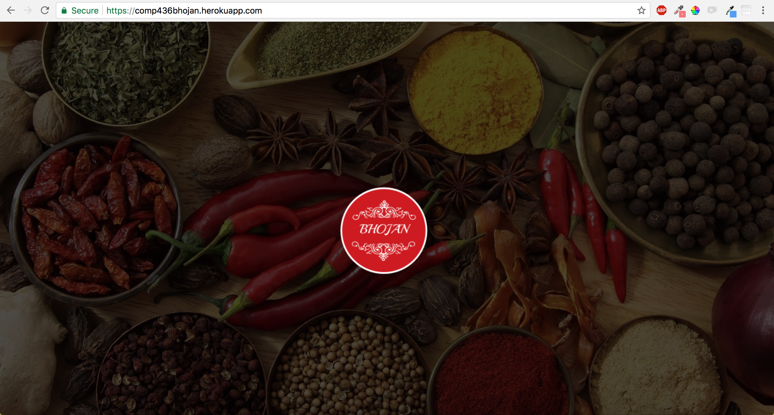
Bhojan: Front Page

Slide 11
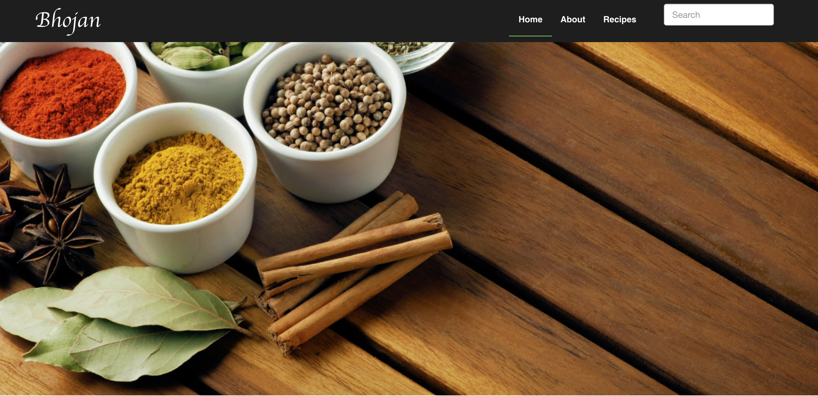
Home Page:

Slide 12
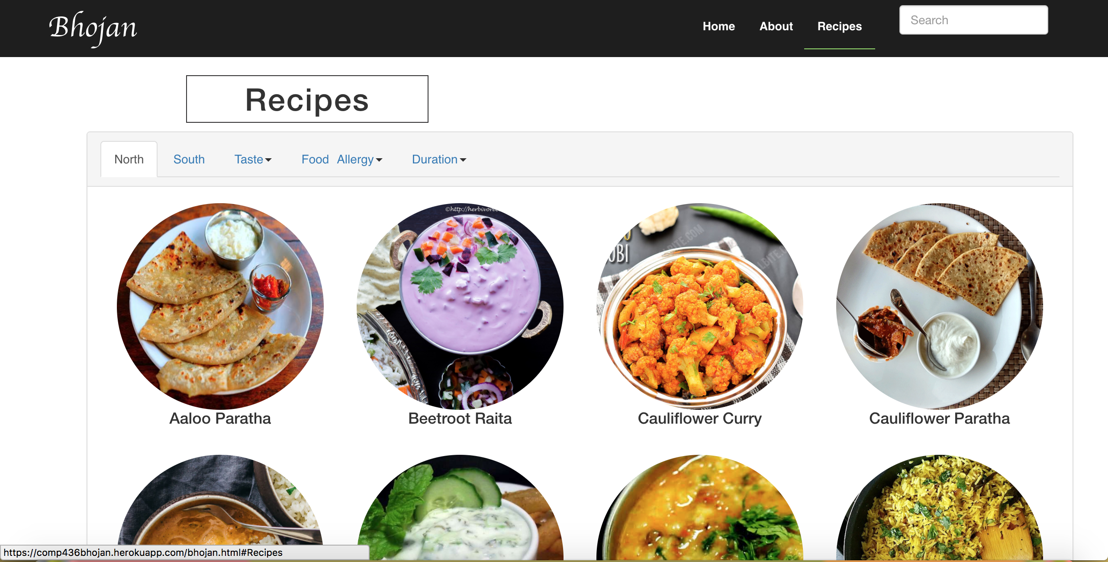
Bhojan: North Indian food

Slide 13
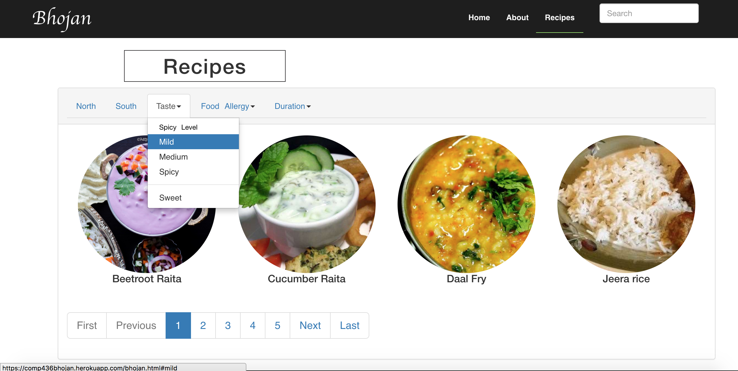
Bhojan: Filter

Slide 14
Thanks
Hope everyone is going to cook Indian food now!! ☺

